Slide 1
GSM &OFDM
GSM (Global system for mobile communication) OFDM(Orthogonal frequency division multiplexer) is used for wireless and telecommunications standard. (4G, 5G, WiMAX satellite)

Slide 2
What is GSM?
It is a digital mobile network that is widely used by mobile phone users around the world.
GSM uses a variation of time division multiple access (TDMA) and is the most widely used of the three digital wireless telephony technologies: TDMA, GSM and code-division multiple access (CDMA).
GSM digitizes and compresses data, then sends it down a channel with two other streams of user data, each in its own time slot. It operates at either the 900 megahertz (MHz) or 1,800 MHz frequency band.

Slide 3
GSM
GSM, together with other technologies, is part of the evolution of wireless mobile telecommunications that includes High-Speed Circuit-Switched Data (HSCSD), General Packet Radio Service (GPRS), Enhanced Data GSM Environment (EDGE) and Universal Mobile Telecommunications Service (UMTS).
The GSM network has four separate parts that work together to function as a whole: the mobile device itself, the base station subsystem (BSS), the network switching subsystem (NSS) and the operation and support subsystem (OSS).

Slide 4
GSM
The BSS handles traffic between the cellphone and the NSS. It consists of two main components: the base transceiver station (BTS) and the base station controller (BSC). The BTS contains the equipment that communicates with the mobile phones, largely the radio transmitter receivers and antennas, while the BSC is the intelligence behind it. The BSC communicates with and controls a group of base transceiver stations.
The NSS portion of the GSM network architecture, often called the core network, tracks the location of callers to enable the delivery of cellular services. Mobile carriers own the NSS. The NSS has a variety of parts, including mobile switching center (MSC) and home location register (HLR).

Slide 5
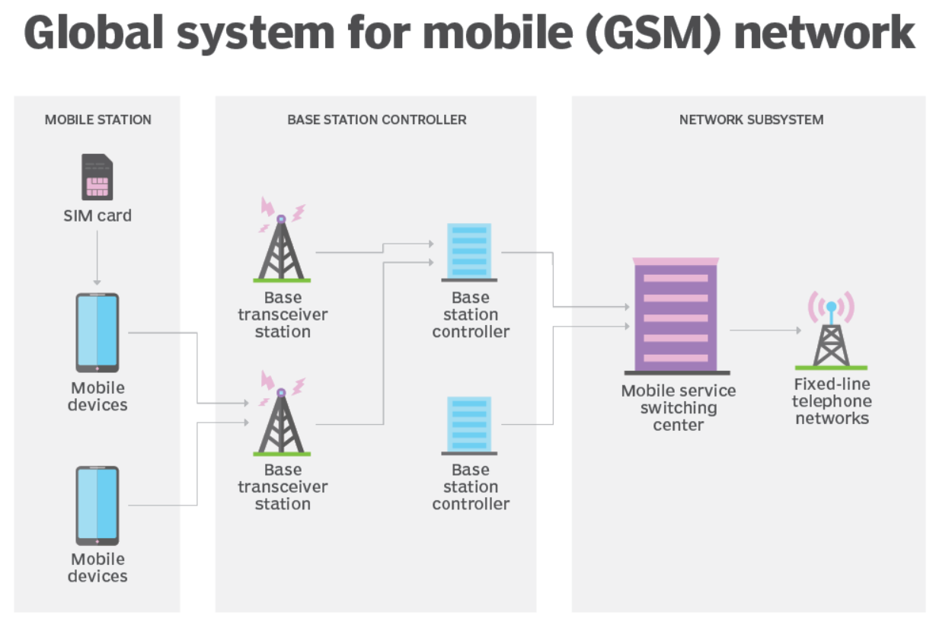

Slide 6
GSM
We have used GSM TC35 for this project. This python library is designed to be integrated in python or shell projects using TC35 module. It is multi-platform and compatible with python 3+.
Most functionalities should work with other GSM module using AT commands.

Slide 7
OFDM
Used for wireless and telecommunication on standard
Channels are closely spaced , there is no guard band between them but also overlapping we can see with the same available bandwidth.
It allows more data transmission than FDM. It prevents interference while multiple sub channels overlap each other.

Slide 8
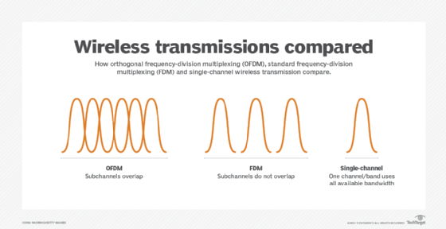

Slide 9
OFDM
so if there are three channels OFDM will take them and place them orthogonal (independent) to each other.
any neighbor signals in OFDM operate without dependence or interference with one another.
when one is at its peak the other two are at zero there for orthogonal means signals are multiplex in a way that the peak of one signal occurs at null point of the other.

Slide 10
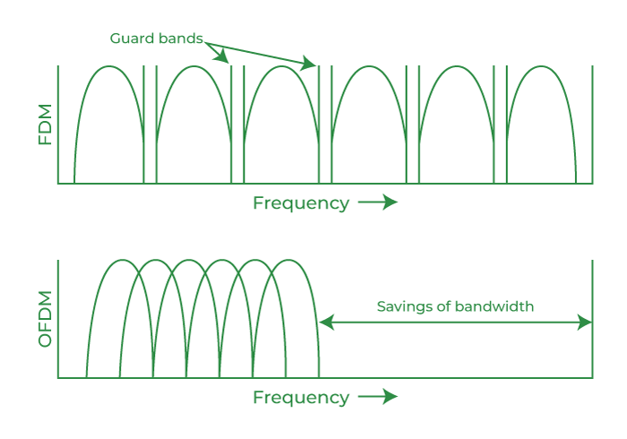

Slide 11
OFDM
at the receiving end the demultiplexer would separate them based on this orthogonal feature.
OFDM would better utilize the available bandwidth thus offering higher data transmission rate than FDM
the ever growing demand mandate more and more efficient Technology having efficient band with utilization and reduced errors etc. So OFDM was introduced.

Slide 12
OFDM
the technique of OFDM is more attractive due to its significant advantages of high spectral efficiency over single careers schemes.
To implement OFDM a FFT can be used to reduce computational complexity.

Slide 13
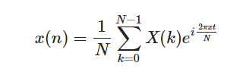
OFDM
The OFDM transmission scheme can be broken down into several components. The data is first coded and modulated, usually into QAM symbols. These symbols are loaded into equally spaced frequency bins and an inverse fast Fourier transform (IFFT) is applied to transform the signal into orthogonal overlapping sinusoids in the time domain. The IFFT is given by the equation:

Slide 14
OFDM
The N samples at the output of the IFFT make up one OFDM symbol. A cyclic prefix is then appended to each OFDM symbol, which allows for computation of circular convolution through linear convolution if the cyclic prefix is at least as long as the channel impulse response. This allows equalization at the receiver to remove intersymbol interference through a straightforward complex scalar multiplication applied to each OFDM symbol independently. In a typical OFDM application, known pilot symbols are added at the transmitter to aid with channel estimation and equalization.

Slide 15
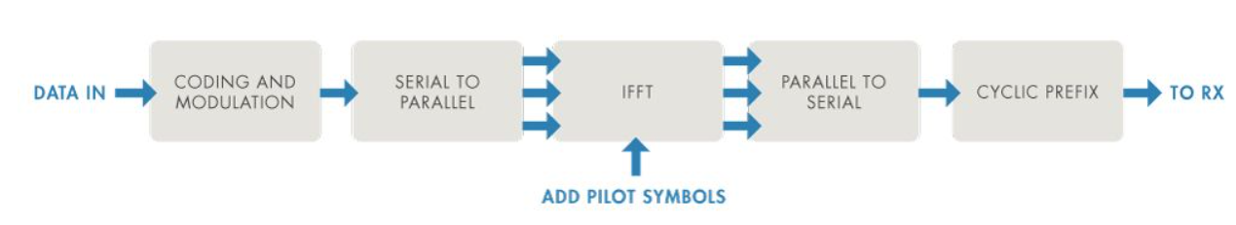
OFDM

Slide 16
OFDM
We are using OFDM modulator in this project . It modulates a signal using OFDM method . The output is a baseband representation of the modulated signal. To modulate a signal using OFDM:
Create the OFDM modulator object and set it’s properties.
Call the object with arguments, as if it were a function.

Slide 17
Thank you

